Slide 1


Bank Credit Risk Analysis With Bayesian Network Decision Tool
Abhishek Sharma
Aishwarya Mandava
Piyush Chopra
Suruchi J. Ahuja

Slide 2
Introduction
Bank credit risk analysis is widely used at all banks all around the world. Credit risk analysis is very critical tedious process, and a variety of techniques is used for risk level calculation.
Credit risk is one of the main functions of the banking community . Banks classify customers according to their profile. Credit risk level can be estimated using a credit scoring system – this method involves scoring customers by using predetermined criteria.
There are subjective factors and objective factors too which depend on bank decision strategy and its mission. Credit scoring system is used to measure both the factors.

Slide 3
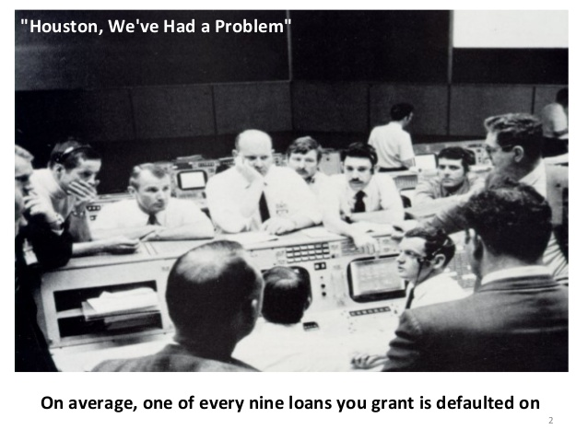

Slide 4
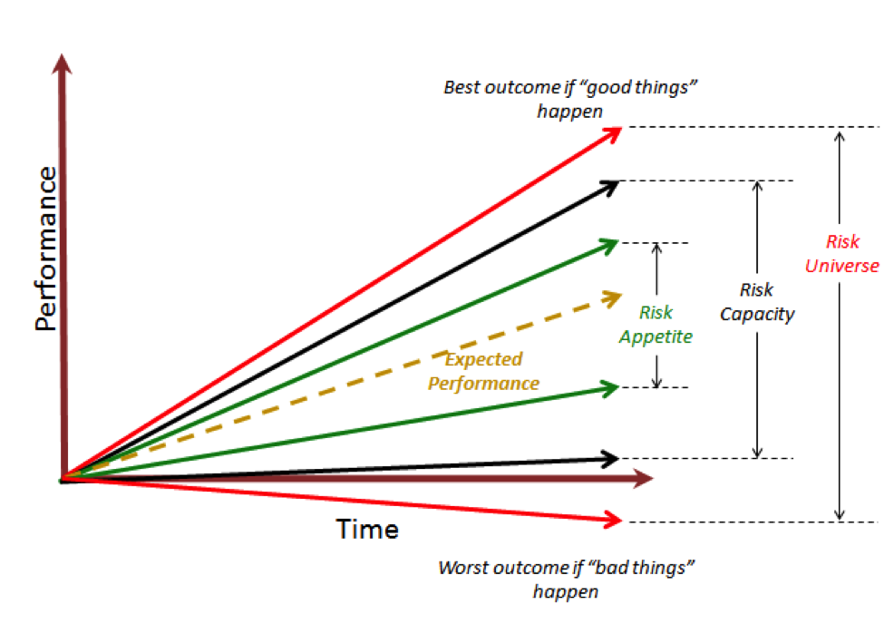
Risk Strategy

Slide 5
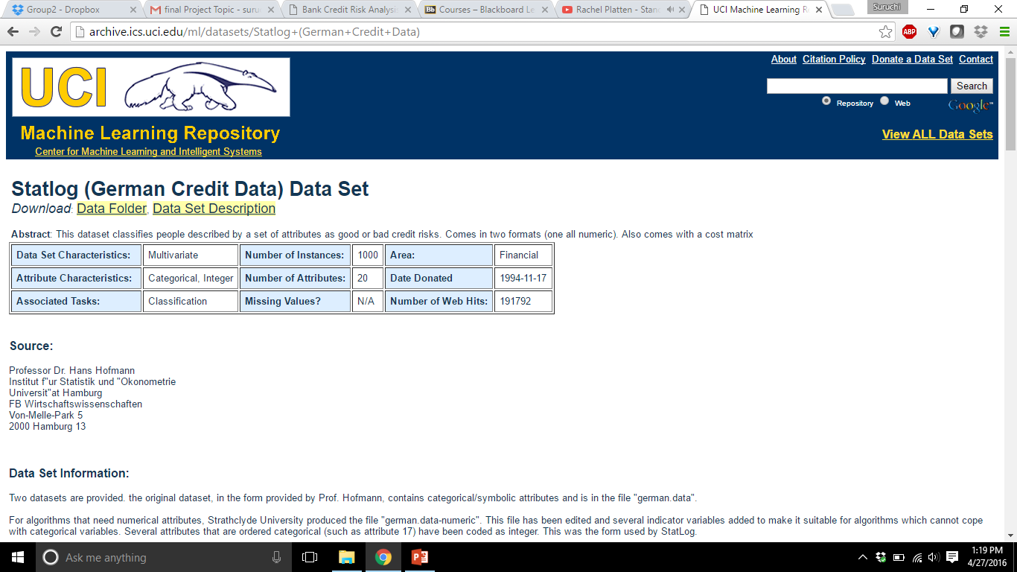
The German Credit Dataset

Slide 6
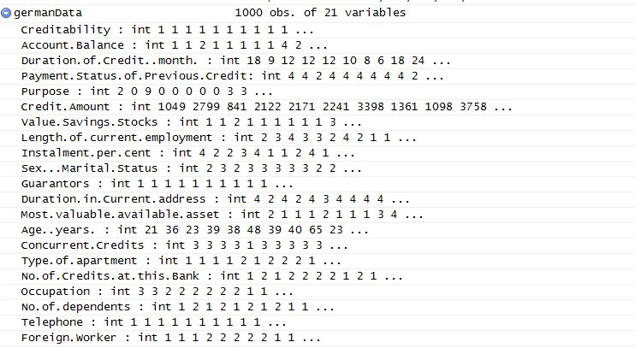

Slide 7
The German Credit Data - 20 variables
Classification as applicant is Good or a Bad credit risk
1000 loan applicants.
Historical pre-loan data
Two types of risks are associated with the bank’s decision for a loan approval are
If the applicant is a good credit risk, i.e. is likely to repay the loan, then not approving the loan to the person results in a loss of business to the bank
If the applicant is a bad credit risk, i.e. is not likely to repay the loan, then approving the loan to the person results in a financial loss to the bank
Data available at UCI machine learning data repository
http://www.ics.uci.edu/~mlearn/MLRepository.html
and on 747 web page
http://www.stat.auckland.ac.nz/~reilly/credit-g.arff

Slide 8
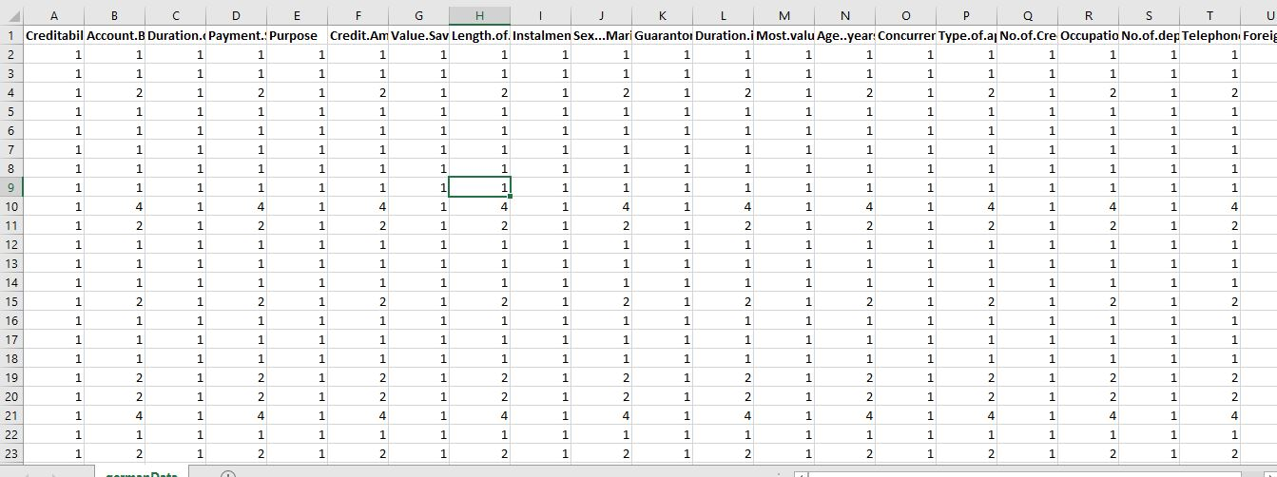
Snapshot of the Data set

Slide 9
Main aim of the project :
New applicants for credit can also be evaluated on these 20 "predictor" variables. We want to develop a credit scoring rule that can be used to determine if a new applicant is a good credit risk or a bad credit risk, based on values for one or more of the predictor variables.
Developing of general techniques to model bank credit risk analysis.
Developing a simple design for a Bayesian network nodes and a simple algorithm for the calculation of probability of conditional tables.
To compare the approaches of various Bayesian network models
General discussion about the advantages of Probabilistic Graphical Models

Slide 10
Bayesian Network
Bayesian Networks - graphical model representing the complete probability distribution and the independencies involved as directed graphs.
It is a very strong decision tool
Capable of doing inferences even when noisy and incomplete data are available.
Representation of both quantitative and qualitative knowledge.
In the bank credit risk analysis, both objective and subjective factors are available. Bayesian Networks consists of nodes and directed links. Each node represents a random variable or events.
Directed links show the cause – effect relation between nodes. Each node has conditional probability tables.
The graph has no directed cycles. This means there is no feedback between nodes. Thus the direction of links is important.

Slide 11
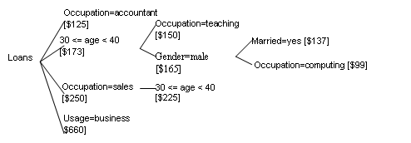
Source of Idea

Slide 12
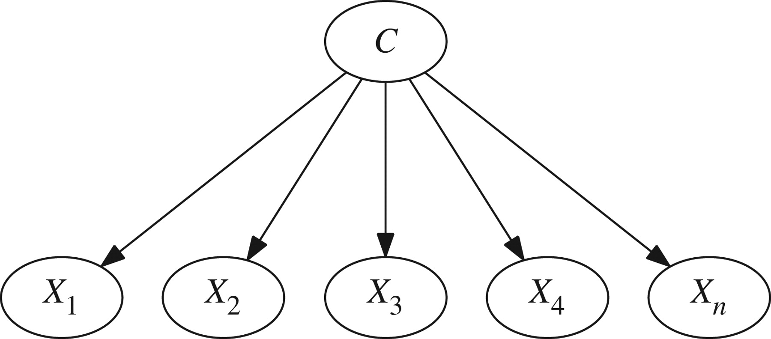
Naïve Bayes

Slide 13
Naïve Bayes
Naive Bayes classifiers - applying Bayes’ theorem with strong (naive)independence assumptions between the features.
Naive Bayes classifiers are highly scalable, requiring a number of parameters linear in the number of variables (features/predictors) in a learning problem.
Maximum-likelihood training can be done by evaluating a closed-form expression, which takes linear time, rather than by expensive iterative approximation as used for many other types of classifiers.
Naive Bayes and Tree Augmented Naive Bayes (TAN) are probabilistic graphical models used for modeling huge datasets involving lots of uncertainties among its various interdependent feature sets.

Slide 14
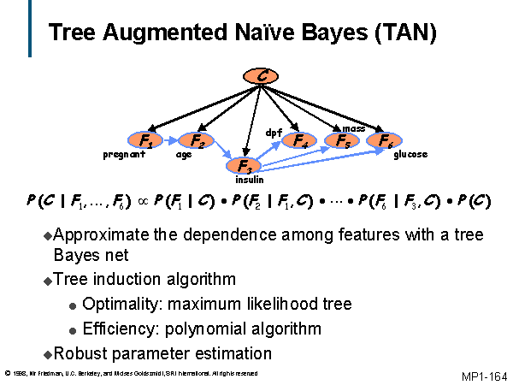

Slide 15
Tree Augmented Naïve Bayes
The TAN model improves on the Naive Bayes model by adding one more level of interaction among attributes of the system.
Every attribute is dependent on its class and one other attribute from the feature set.
Since this model incorporates the dependencies among the attributes, it is more realistic than a Naive Bayes model.
The TAN model gives better performance results if there are correlations between the attributes but the performance is almost the same as that of Naive Bayes model, if there are not enough correlations between the attributes of the system.

Slide 16
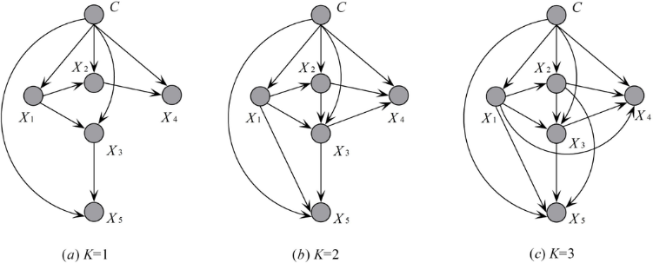

Slide 17
k-fold Cross-Validation
For smaller datasets, use k-fold cross-validation
Split dataset into k roughly equal parts
For each part, train on the other k-1 parts and use this part as the test dataset
Do this for each of the k parts, and average the resulting prediction errors
This method measures the prediction error when training the learner on a fraction (k-1)/k of the data
If k is small, this will overestimate the prediction error
k=10 is usually enough

Slide 18
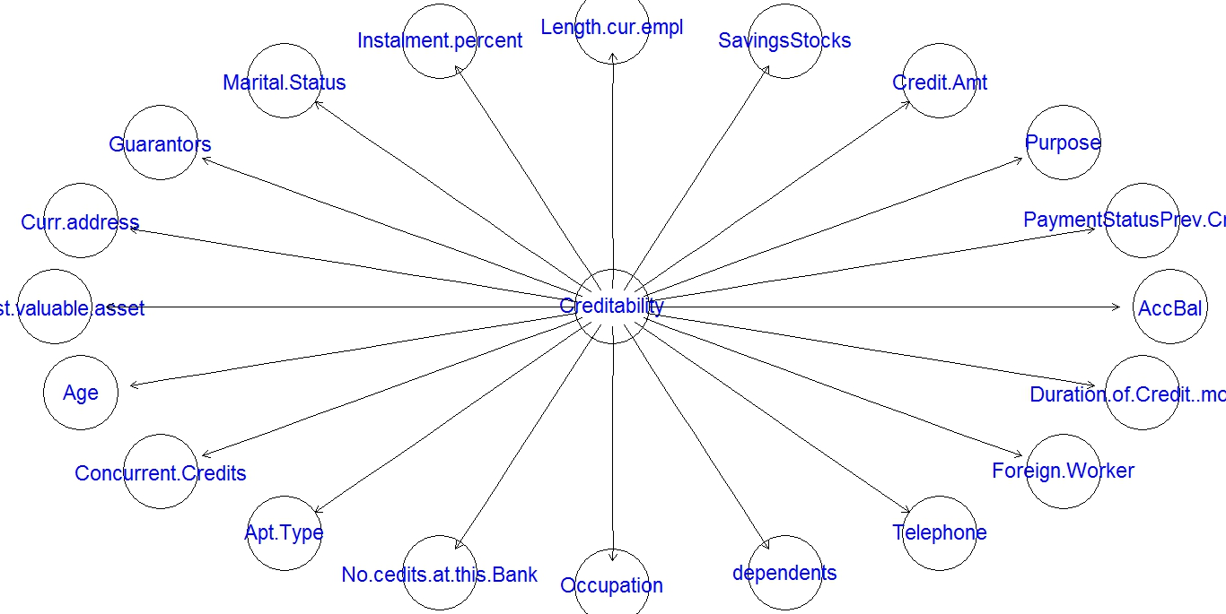
Naïve Bayes
Naïve Bayes

Slide 19
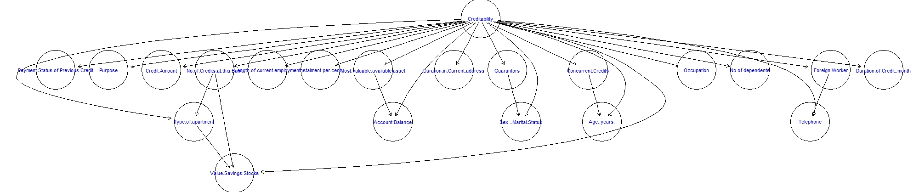
Backward sequential elimination and joining (BSEJ)

Slide 20
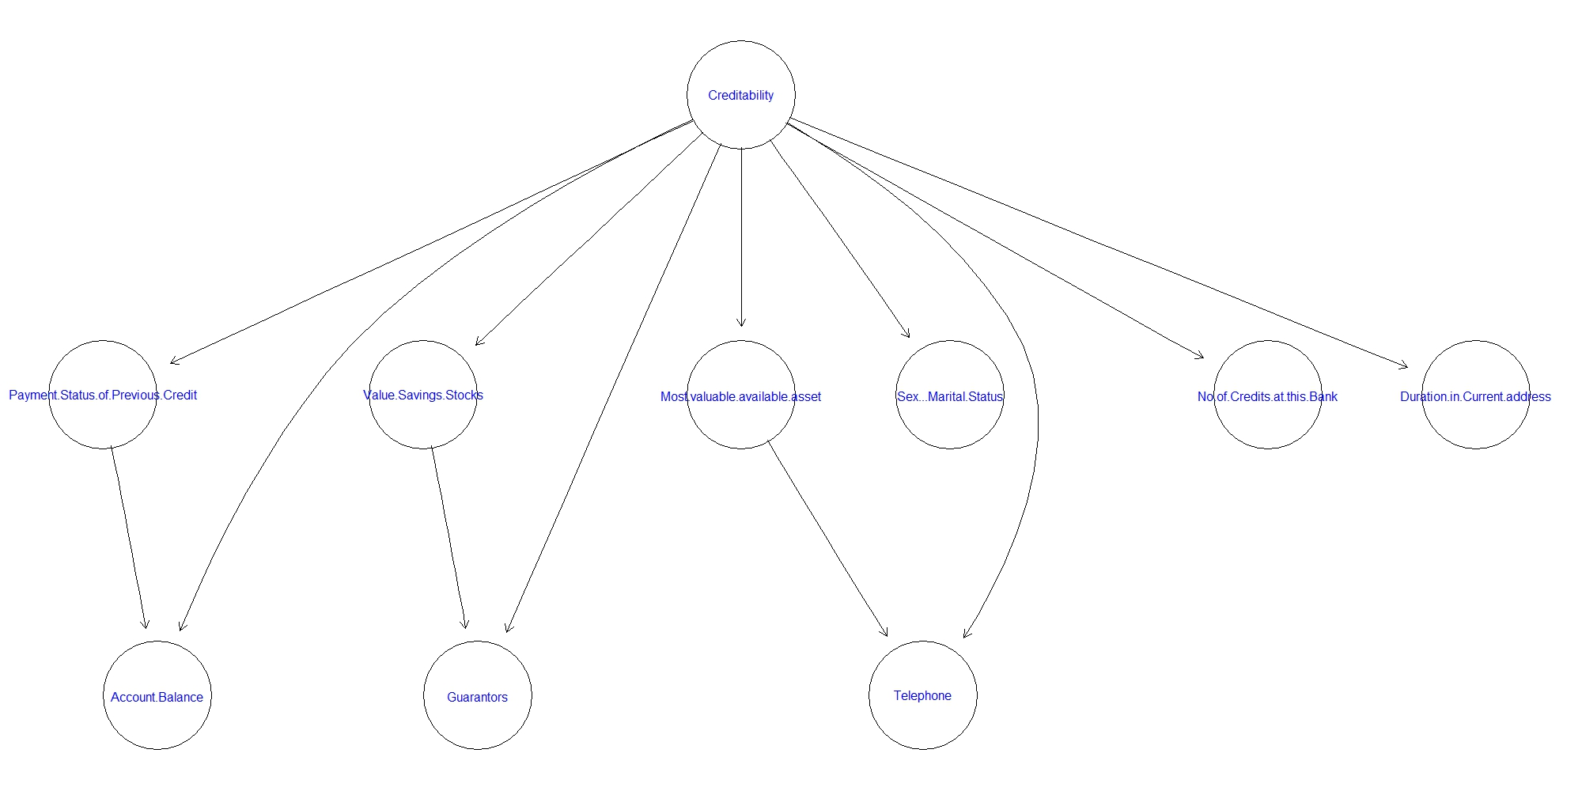
Forward sequential selection and joining (FSSJ)

Slide 21
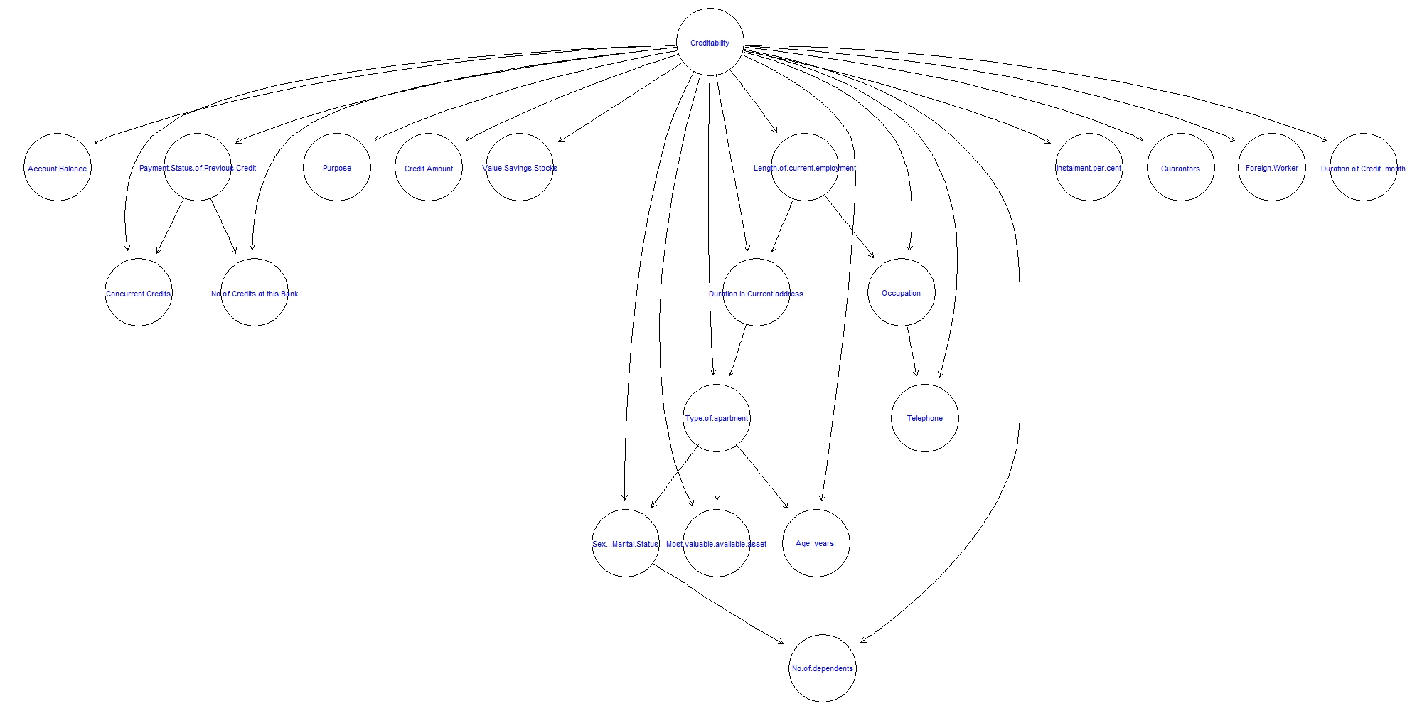
Chow-Liu’s algorithm for one-dependence estimators

Slide 22
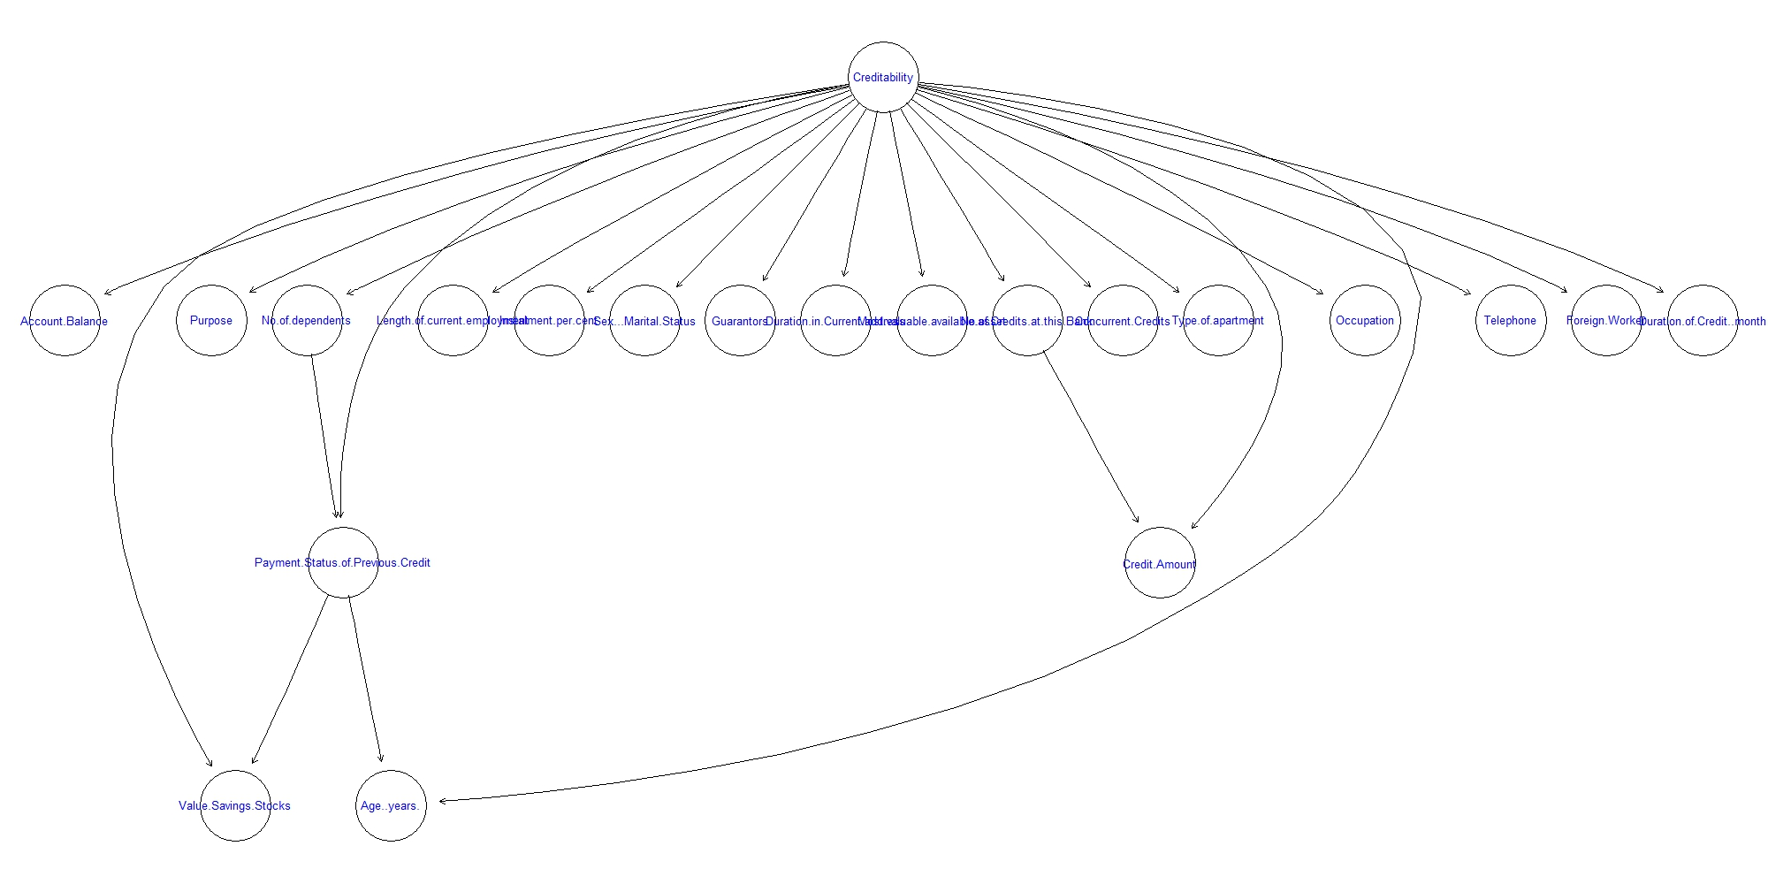
Hill-climbing tree augmented naive Bayes

Slide 23
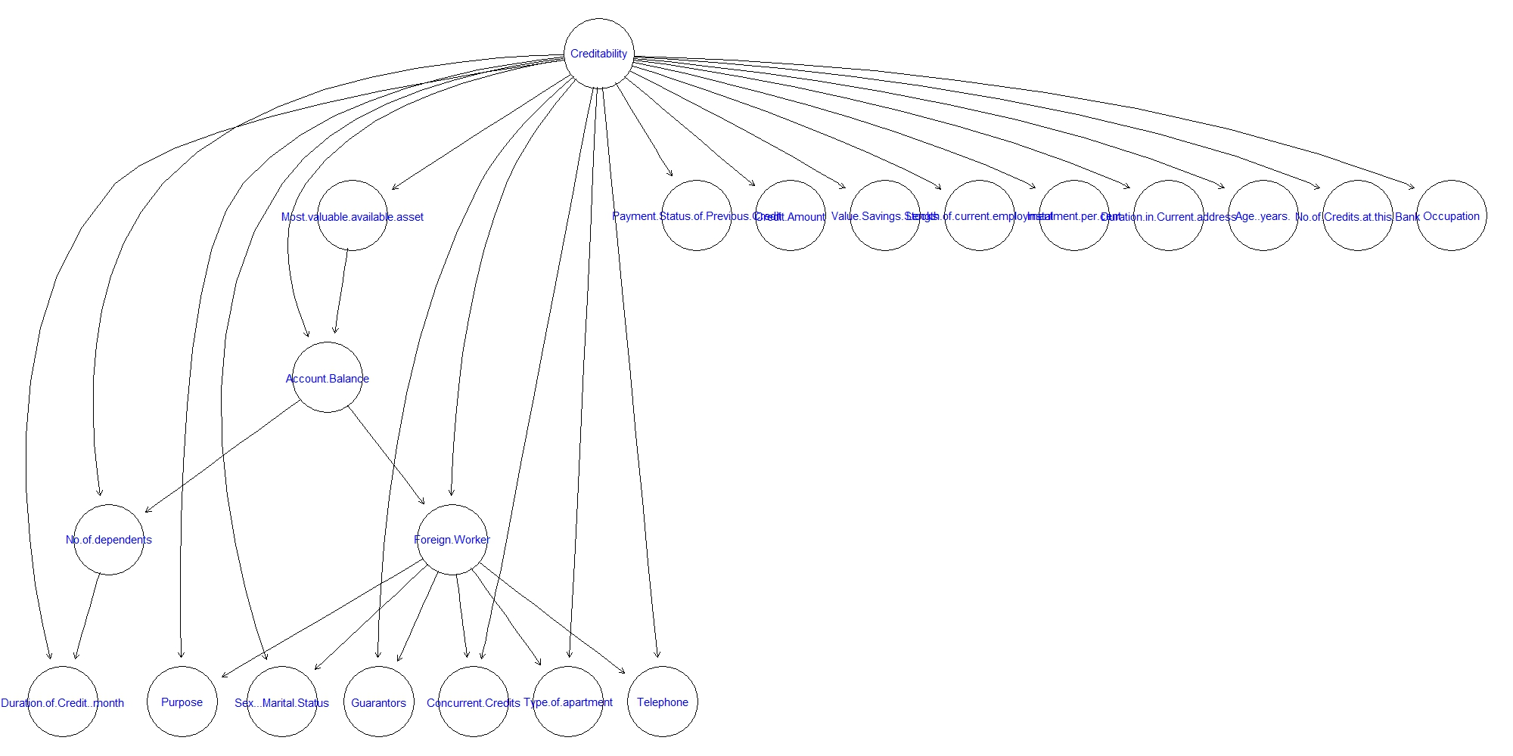
Hill-climbing super-parent tree augmented naive Bayes

Slide 24
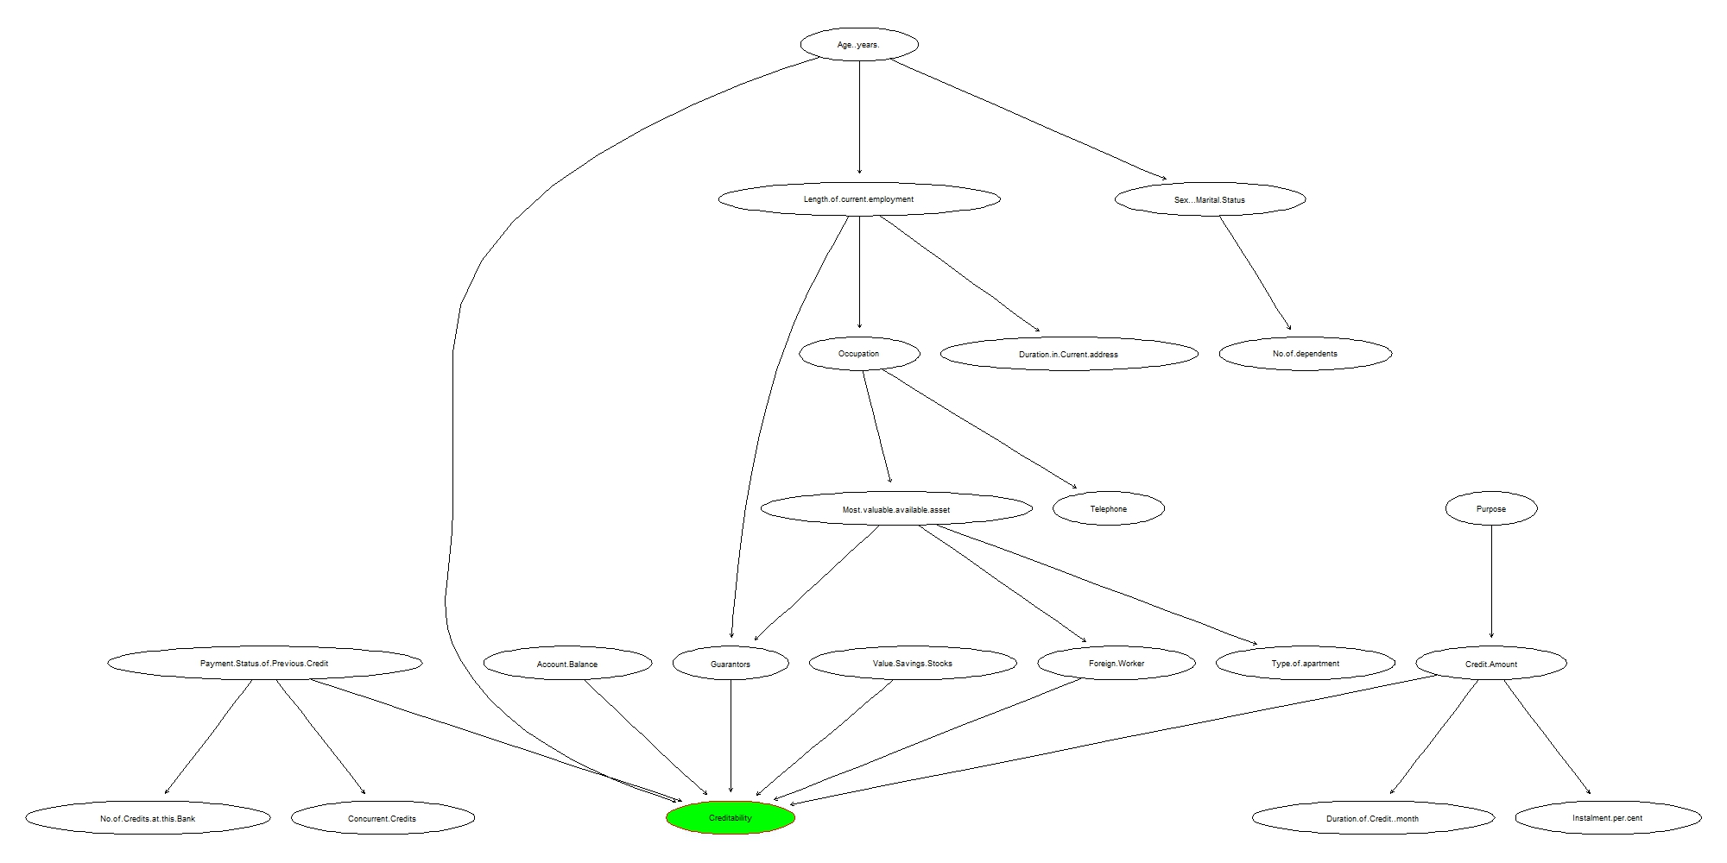
Hill-Climbing Score Based

Slide 25
Model Name
0.787
Chow-Liu’s
0.803
Hill-Climbin TAN
0.804
Hill-Climbing Super Parent- TAN
0.787
Forward sequential selection and joining (FSSJ)
Backward sequential elimination and joining (BSEJ)
0.789
Hill-Climbing Score Based
0.89
Accuracy
Naïve bayes
0.774

Slide 26
Penalty Matrix
1 = Good 2 = Bad | Predicted | Predicted Good | Predicted Bad
 | Penalties | 1 | 2
Actual Good | 1 | 0 | 1
Actual Bad | 2 | 5 | 0

Slide 27
Cost-Profit Calculations
 | TYPE-1 | TYPE-2 | TOTAL
TAN-CL | 80 | 117 | -505
TAN-HC | 77 | 118 | -513
TAN-HCSP | 84 | 125 | -541
FSSJ | 70 | 158 | -720
BSEJ | 77 | 122 | -533
HC-SCORE BASED | 49 | 54 | -221

Slide 28
Results
The model suggests that the following characteristic usually tend to show Higher risks
Lower balances in checking and savings
Have delinquent previous credit history
Have no guarantors
Have more than one Installment plans
Is a foreign Worker
Has a young age
Notes:
These are the results have to work on probing this .. Querying on our network

Slide 29
SCOPE AND FURTHER ANALYSIS
Prepare a cluster based Bayesian network wherein a set of features are grouped into a cluster and each cluster represents an additional node
This enables forming a Network where-in Similar features are grouped into a cluster and represent a generic characteristic of a Person eg. Features like age, sex, No.of Dependants are grouped into a cluster representing Personal info of a Person.
Determine CPT’s for this clusters which constitute latent nodes.
Another approach would be to form a score based network where-in the final credibility is determined based on the SUM of scores at individual stages.
Gain more Understanding based on expert knowledge.

